Slide 1
Devops – CI/CD jenkins
23-11-2020 to 27-11-2020
Venkatesh Reddy Madduri && ShankarPrasad

Slide 2
Agenda
Introduction
Git & GitHub
Continuous Integration Using Jenkins
Introduction to Docker
Kubernetes
Ansible
Continuous Monitoring using Nagios
DevOps Project

Slide 3
What is Jenkins
Jenkins is an open source automation tool written in Java programming language that allows continuous integration.
Jenkins builds and tests our software projects which continuously making it easier for developers to integrate changes to the project, and making it easier for users to obtain a fresh build.
It also allows us to continuously deliver our software by integrating with a large number of testing and deployment technologies.
Jenkins offers a straightforward way to set up a continuous integration or continuous delivery environment for almost any combination of languages and source code repositories using pipelines, as well as automating other routine development tasks.
Notes:
Add docker icon

Slide 4
What is Jenkins ..
With the help of Jenkins, organizations can speed up the software development process through automation. Jenkins adds development life-cycle processes of all kinds, including build, document, test, package, stage, deploy static analysis and much more.
Jenkins achieves CI (Continuous Integration) with the help of plugins. Plugins is used to allow the integration of various DevOps stages. If you want to integrate a particular tool, you have to install the plugins for that tool. For example: Maven 2 Project, Git, HTML Publisher, Amazon EC2, etc.
For example: If any organization is developing a project, then Jenkins will continuously test your project builds and show you the errors in early stages of your development.
Possible steps executed by Jenkins are for example:
Perform a software build using a build system like Gradle or Maven Apache
Execute a shell script.
Archive a build result.
Running software tests.
Notes:
Add docker icon

Slide 5
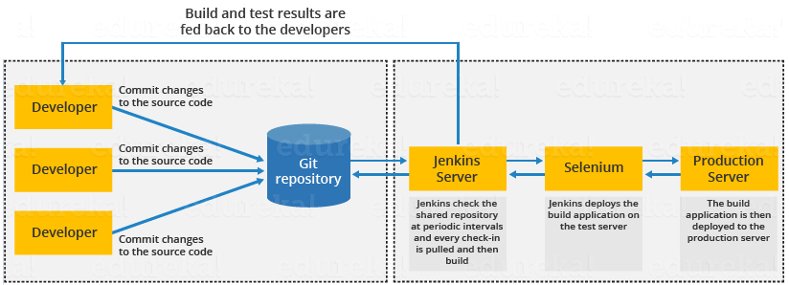
Jenkins Work Flow
Notes:
Add docker icon

Slide 6
Advantages and Disadvantages of Jenkins
Advantages of Jenkins
It is an open source, free of cost, Easy support since widely used.
It does not require additional installations or components. Means it is easy to install.
Easily configurable.
It supports 1000 or more plugins to ease your work. If a plugin does not exist, you can write the script for it and share with community.
It is built in java and hence it is portable.
It is platform independent. It is available for all platforms and different operating systems. Like OS X, Windows or Linux.
Jenkins also supports cloud based architecture so that we can deploy Jenkins in cloud based platforms.
Notes:
Add docker icon

Slide 7
Advantages and Disadvantages of Jenkins
Disadvantages of Jenkins
Its interface is out dated and not user friendly compared to current user interface trends.
Not easy to maintain it because it runs on a server and requires some skills as server administrator to monitor its activity.
CI regularly breaks due to some small setting changes. CI will be paused and therefore requires some developer's team attention.
Notes:
Add docker icon

Slide 8
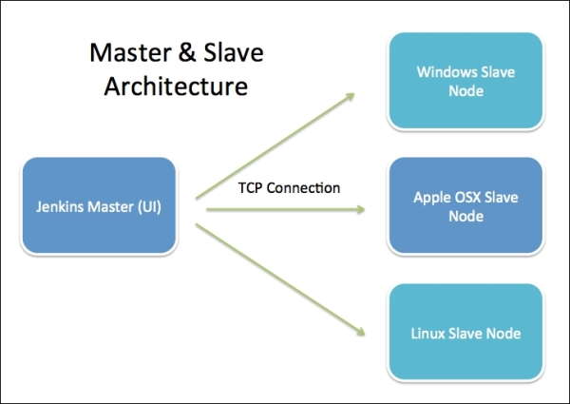
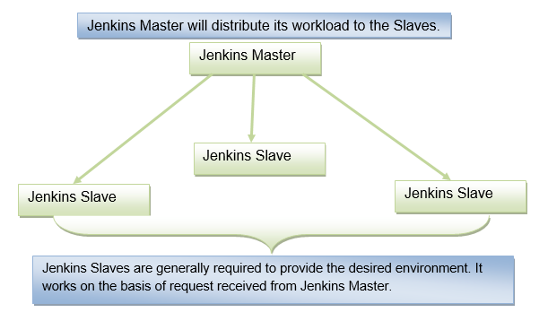
Jenkins Architecture
Jenkins follows Master-Slave architecture to manage distributed builds. In this architecture, slave and master communicate through TCP/IP protocol.
Jenkins architecture has two components:
Jenkins Master/Server
Jenkins Slave/Node/Build Server
Notes:
Add docker icon

Slide 9
Jenkins Master
The main server of Jenkins is the Jenkins Master. It is a web dashboard which is nothing but powered from a war file. By default it runs on 8080 port. With the help of Dashboard, we can configure the jobs/projects but the build takes place in Nodes/Slave. By default one node (slave) is configured and running in Jenkins server. We can add more nodes using IP address, user name and password using the ssh, jnlp or webstart methods.
The server's job or master's job is to handle:
Scheduling build jobs.
Dispatching builds to the nodes/slaves for the actual execution.
Monitor the nodes/slaves (possibly taking them online and offline as required).
Recording and presenting the build results.
A Master/Server instance of Jenkins can also execute build jobs directly.
Notes:
Add docker icon

Slide 10
Jenkins Slave
Jenkins slave is used to execute the build jobs dispatched by the master. We can configure a project to always run on a particular slave machine, or particular type of slave machine, or simple let the Jenkins to pick the next available slave/node.
As we know Jenkins is developed using Java is platform independent thus Jenkins Master/Servers and Slave/nodes can be configured in any servers including Linux, Windows, and Mac.
Notes:
Add docker icon

Slide 11
Installing Jenkins
Hardware Requirements
Memory | 2 GB RAM (Recommended)
Disk Space | We need at least 1 GB of space in our hard drive for Jenkins
Software Requirements
JDK | We need either Java Development (JDK) or Java Runtime Environment (JRE)
Operating System | Jenkins can be installed on Windows, Mac OS X, Ubuntu/Debian, Red Hat/Fedora/CentOS, openSUSE, FReeBSD, OpenBSD, Gentoo.
Java Container | The WAR (Web Application Resource) file can be run in any container that supports Servlet 2.4/JSP 2.0 or later. (For example Tomcat 5).
Release Types
Long term support release (LTS): Long-term support releases (LTS) are available every 12 weeks. They are stable and are widely used and tested. Basically, this release is intended for end users.
Weekly release: This release is available in every week by fixing bugs in its earlier version. These releases are intended towards plugin developers.
Notes:
Add docker icon

Slide 12
Jenkins Setup
Update /etc/yum.repos.d/jenkins.repo
#sudo wget -O /etc/yum.repos.d/jenkins.repo https://pkg.jenkins.io/redhat-stable/jenkins.repo
Import jenkins.io.key
#sudo rpm --import https://pkg.jenkins.io/redhat-stable/jenkins.io.key
Install any latest upgrade
#sudo yum upgrade
Install Jenkins and Java
#sudo yum install jenkins java-1.8.0-openjdk-devel
Reload the configuration
#sudo systemctl daemon-reload
Start, Check Status and Stop Jenkins
#sudo systemctl start jenkins
#sudo systemctl status jenkins
#sudo systemctl stop jenkins
Notes:
Add docker icon

Slide 13
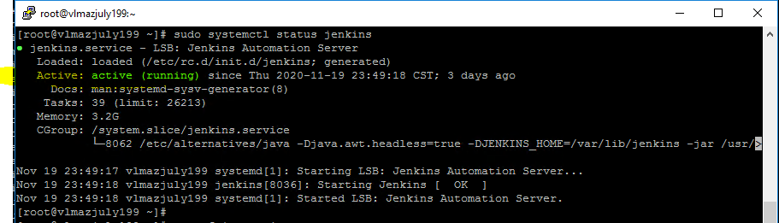
Jenkins Setup Verification
sudo systemctl status jenkins
Note :-Type ‘q’ for command prompt after above command.
Notes:
Add docker icon

Slide 14
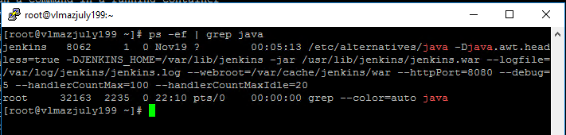
Jenkins Setup Verification
ps –ef | grep java
Note :-Check Jenkin Java Process is running.
Notes:
Add docker icon

Slide 15

Thank you

